Slide 1
Vajes
Y lo que hacemos en nuestro tiempo libre

Slide 2
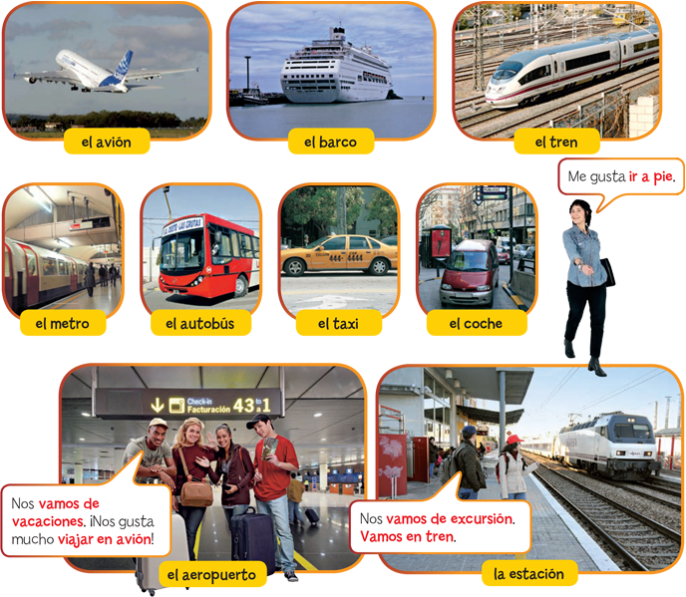
De viajes

Slide 3
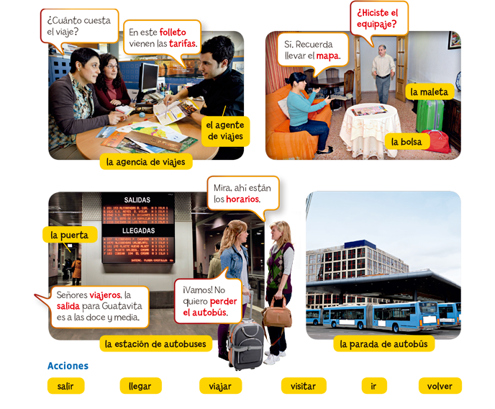
Excursiones

Slide 4
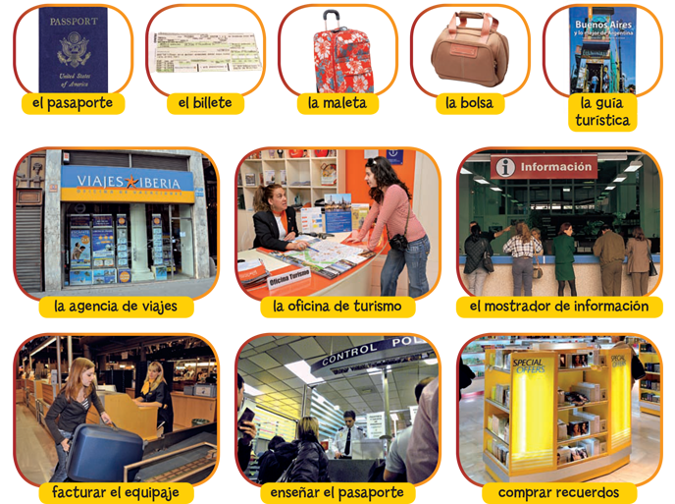
Preparación

Slide 5
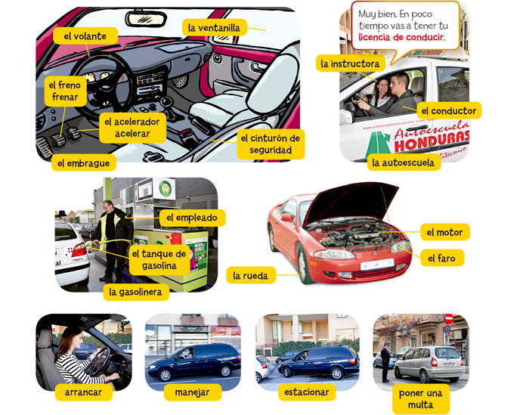
Tu Coche

Slide 6
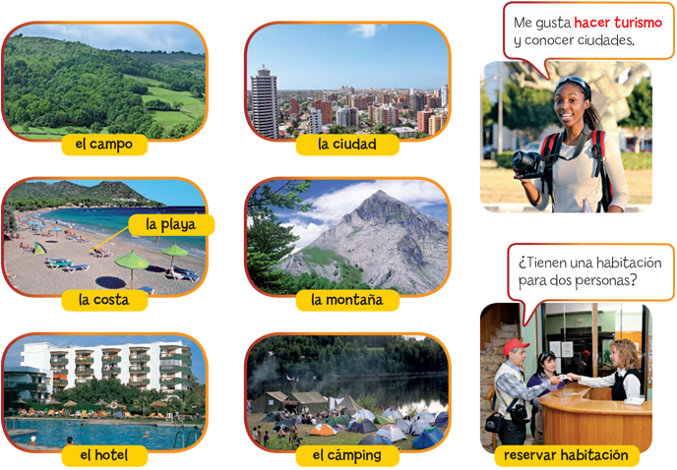
Los lugares Turístcos

Slide 7
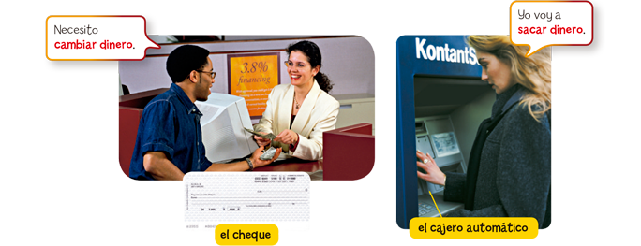
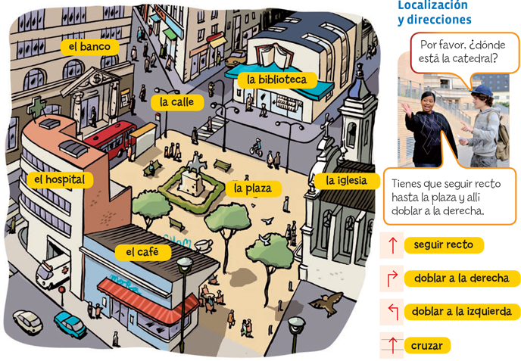
La Ciudad

Slide 8
El Imperfecto
We use the imperfect tense to talk about habitual actions or actions that happened repeatedly in the past.
 | Viajar | Volver | Salir
yo tú usted, él, ella | viajaba viajabas viajaba | volvía volvías volvía | salía salías salía
nosotros, nosotras vosotros, vosotras ustedes, ellos, ellas | viajábamos viajabais viajaban | volvíamos volvíais volvían | salíamos salíais salían
Some expressions that indicate frequency, like siempre, muchas veces, a menudo, or generalmente, can be used with the imperfect. You can also use these other expressions with the imperfect to express that an action was habitual:
 | antes | de pequeño(a) | cuando era pequeño(a)
 | entonces | de niño(a) | cuando era joven

Slide 9
Irregulares del imperfecto
There are only three irregular verbs in the imperfect tense: ser, ir, and ver. The other verbs are regular.
 | Ser | Ir | Ver
yo tú usted, él, ella | era eras era | iba ibas iba | veía veías veía
nosotros, nosotras vosotros, vosotras ustedes, ellos, ellas | éramos erais eran | íbamos ibais iban | veíamos veíais veían

Slide 10
Narrar en el pasado
When telling a story in the past, we use both the preterite and the imperfect tenses:
In general, use the preterite to talk about past actions or events that are presented as completed actions. Use the preterite to talk about past actions or events that happened in the story.
On the other hand, use the imperfect to talk about ongoing actions or events in the past, without mentioning the end.Use the imperfect to describe characters and setting, and, in general, to explain the circumstances surrounding an event.
The preterite and the imperfect are used frequently in the same sentence to talk about past actions that coincided in time.
To relate two past actions you can use the conjunctions cuando and mientras.
Acción terminada (pretérito) | Acción no terminada (imperfecto)
Ana bajó la escalera. | Ana bajaba la escalera.

Slide 11
Cambio en significado
Some verbs express a different meaning if they are used in the preterite or in the imperfect.
Imperfect | Preterite
Yo conocía a Nela. (I knew Nela.) | Yo conocí a Nela. (I met Nela.)
Tú podías ir a casa. (You could go home.) | Tú pudiste ir a casa. (You managed to go home.)
Ella quería llamar. (She wanted to call.) | Ella quiso llamar. (She tried to call.)
Tú sabías la verdad. (You knew the truth.) | Tú supiste la verdad. (You found out the truth.)

Slide 12
Te toca
Dígame una cuenta que pasó este año escolar. (You will have to do this on the final)

